Slide 1

Assignment 6
Group member: 孙逸涵 张旭东
SID: 12012128 12011923

Slide 2
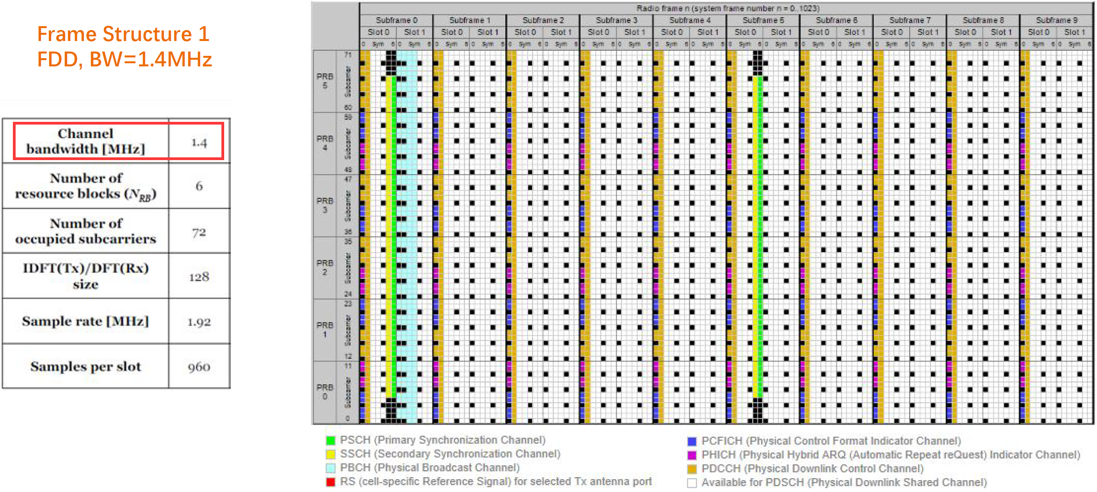
REs organized into CCEs with 1.4MHz bandwidth & CFI = 2
1.4MHz bandwidth

Slide 3
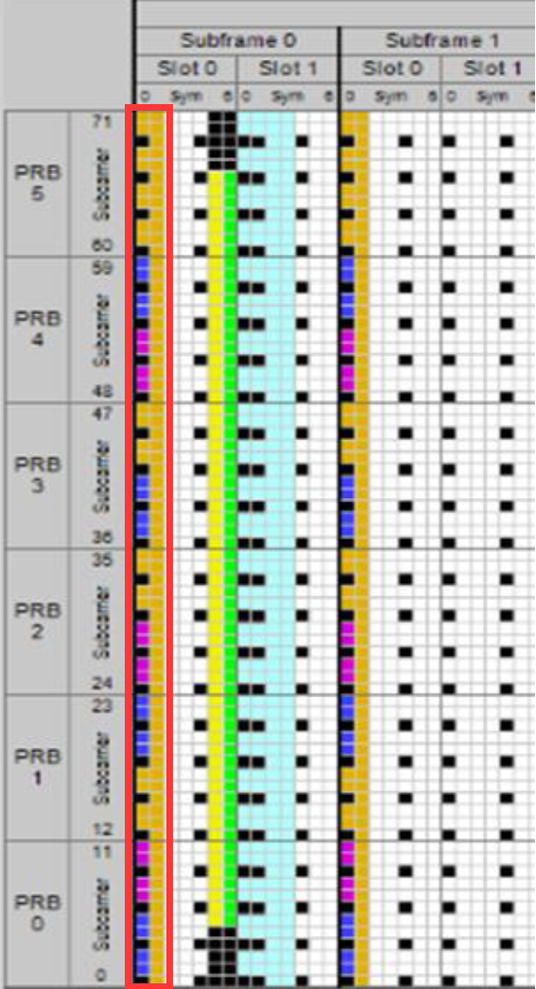
REs organized into CCEs with 1.4MHz bandwidth & CFI = 2
The physical control format indicator channel carries information about the number of OFDM symbols used for transmission of PDCCHs in a subframe.
CFI = 2
Number of OFDM symbols used for transmission of PDCCHs in a subframe
= 2

Slide 4
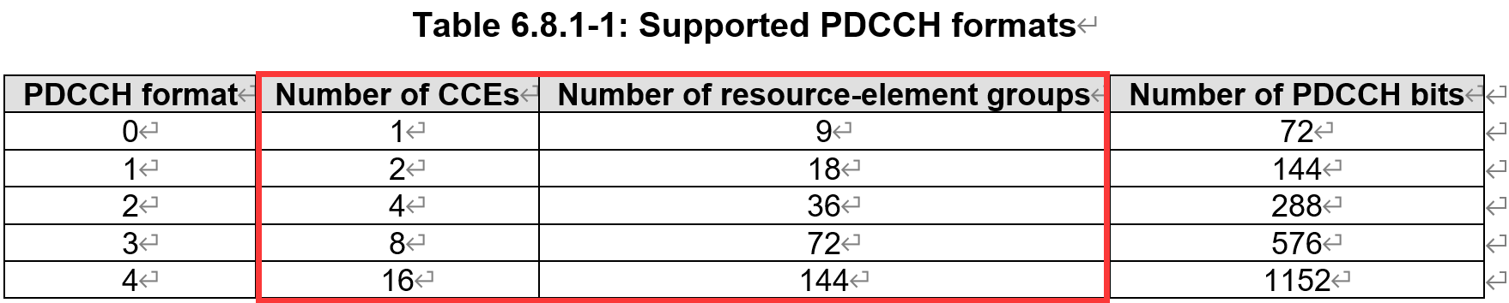
REs organized into CCEs with 1.4MHz bandwidth & CFI = 2
1 CCE = 9 logically continuous REG
1 REG = 4 RE for PDCCH
1 CCE = 36 RE for PDCCH

Slide 5
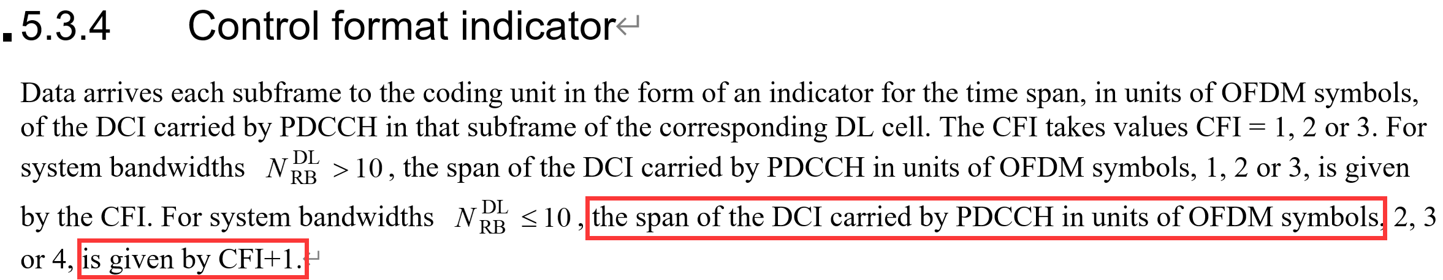
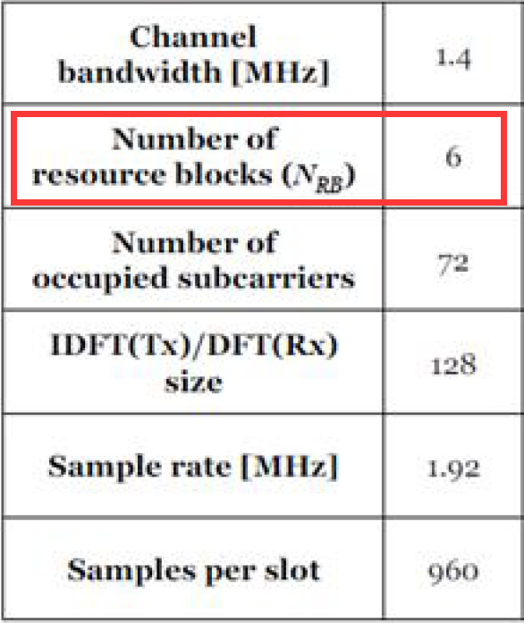
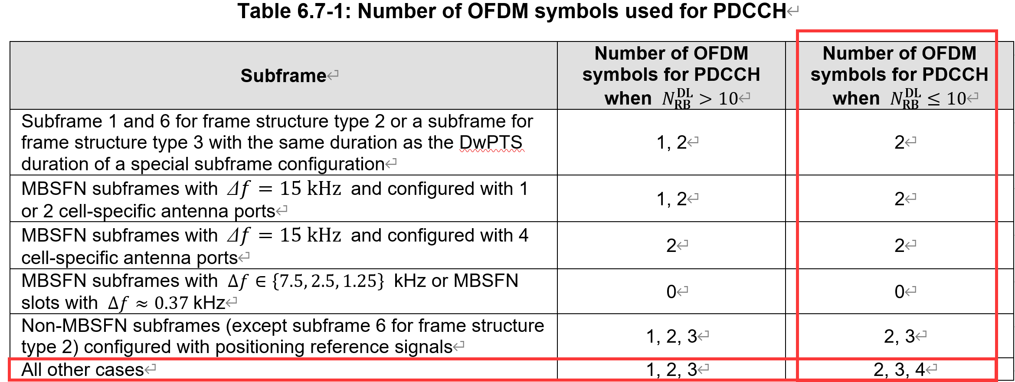
REs organized into CCEs with 1.4MHz bandwidth & CFI = 2
# OFDM symbols = CFI+1 = 3

Slide 6
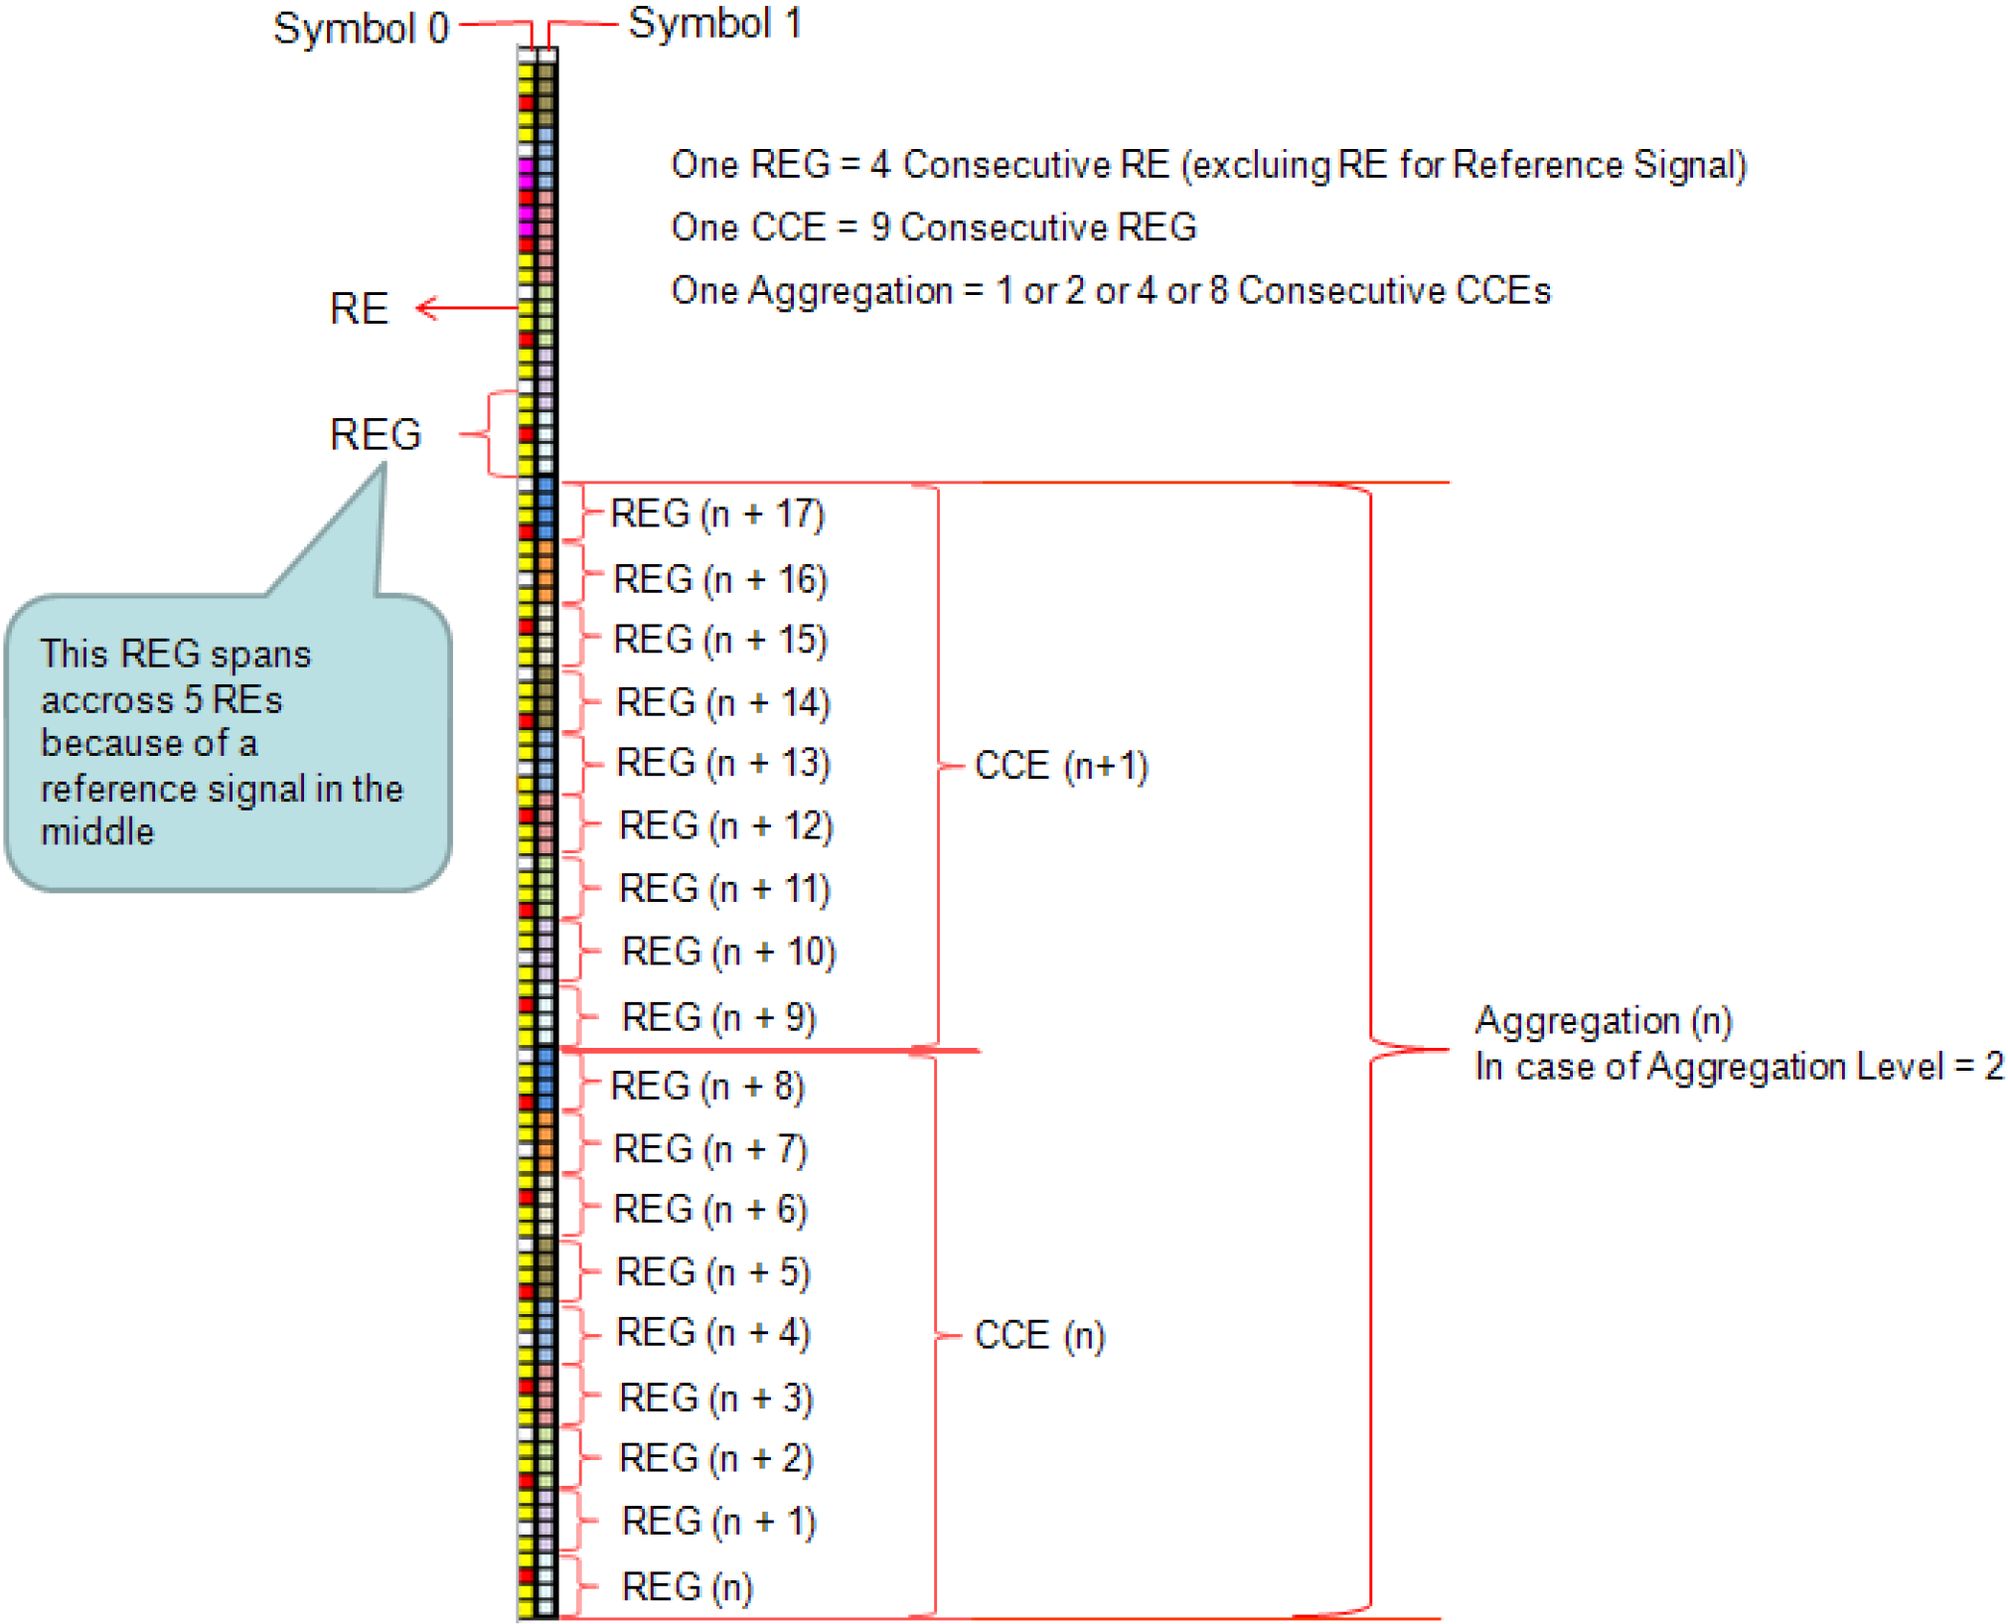
REs organized into CCEs with 1.4MHz bandwidth & CFI = 2
For 1.4MHz system, there are 6 RBs in one slot. And for each subframe, there are two symbols used to transmit control information. Because of that, there are 72×2=144 REs to transmit control information. And each CCE contains 4×9=36 REs. So we may use 144/36=4 CCEs to transmit control information.

Slide 7
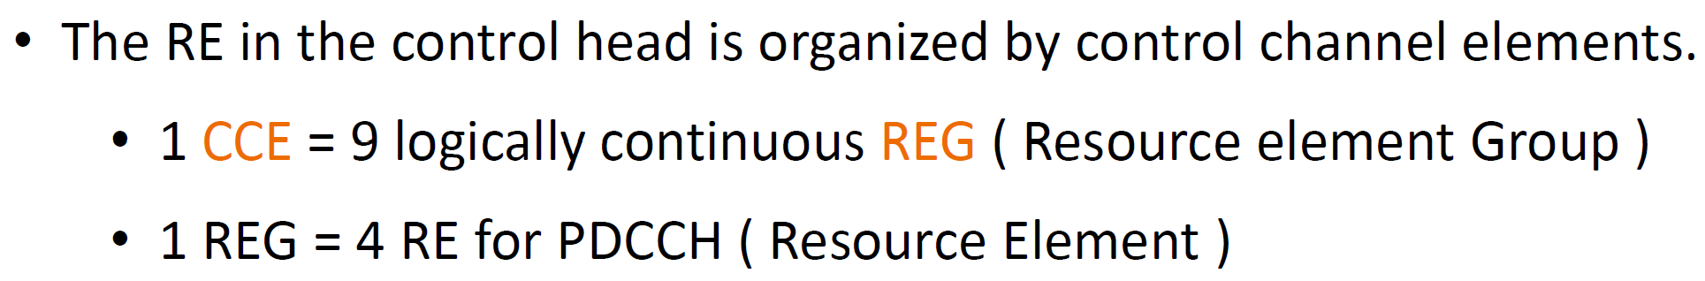
REs organized into CCEs with 1.4MHz bandwidth & CFI = 2

Slide 8
REs organized into CCEs with 1.4MHz bandwidth & CFI = 2
From the analysis above, we can conclude that one DCI is carried by one or multiple CCE. In the last slide of CCE aggregation, the number of OFDM symbols to transmit one CCE carrying one part of one DCI is 3. One CCE consists of 9 REGs, so these 3 symbols transmit a total of 9 REGs. Besides, one REG consists of 4 REs for PDCCH, which means these 3 symbols transmit a total of 36 REs.

Slide 9
Thank you!
Yihan Sun: 12012128@mail.sustech.edu.cn
Xudong Zhang: 12011923@mail.sustech.edu.cn

